Slide 1
DOCUMENT IDENTIFICATION WITH CONVOLUTIONAL NEURAL NETWORKS
Group-5
Renu Gopal Reddy Durgampudi
Jack Curm
Geetha Ganji

Slide 2
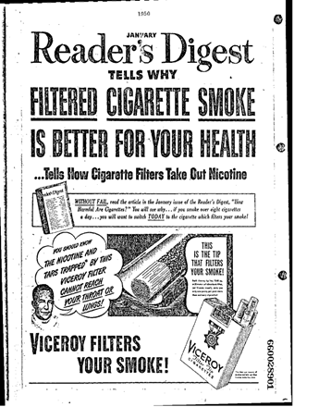
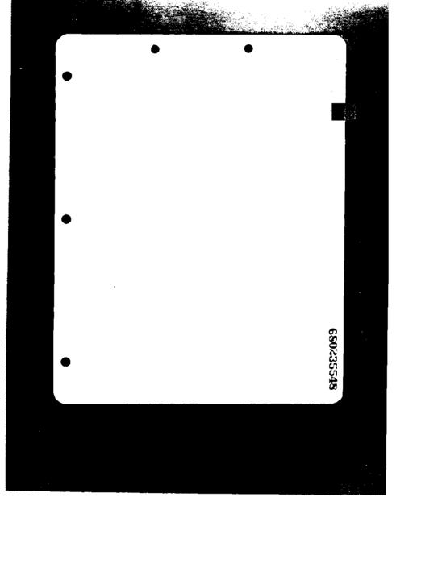
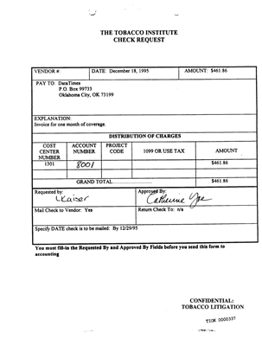

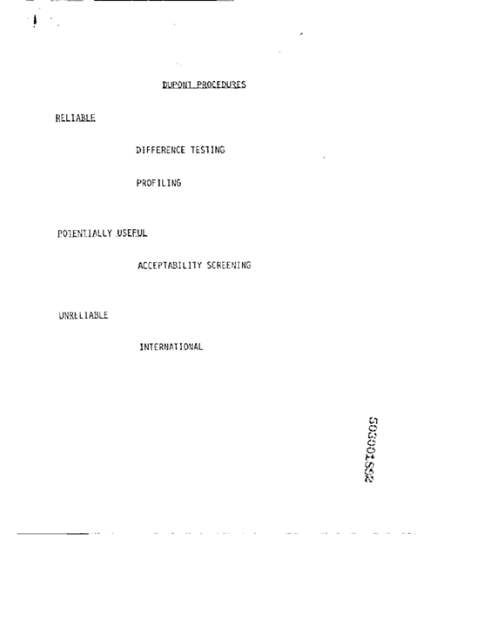
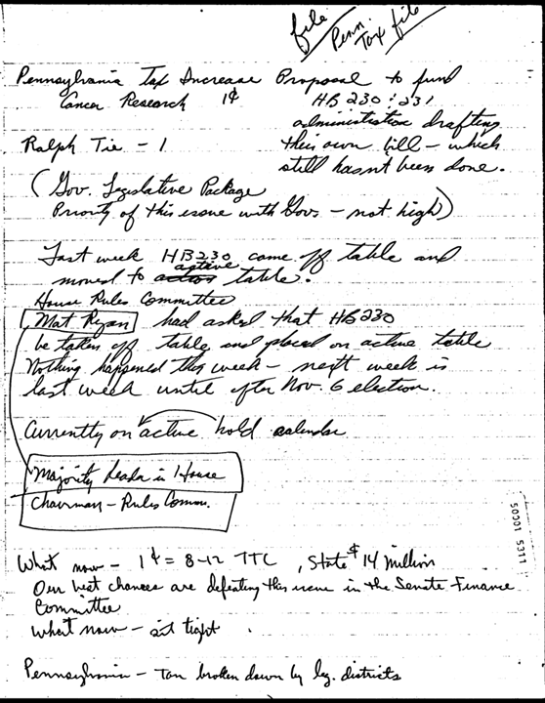
RVL-CDIP DATASET
Ryerson Vision Lab Complex Document Information Processing
Data consists of digitally scanned documents of various types.
Presplit into 320,000 training, 40,000 validation, and 40,000 testing images
20,000 training per class, 2500 testing and validation per class
16 document classes: letter, form, email, handwritten, advertisement, scientific report, scientific publication, specification, file folder, news article, budget, invoice, presentation, questionnaire, resume, and memo

Slide 3
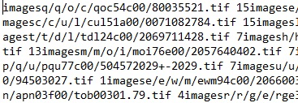
DATA CLEANING
0. letter
1. form
2. email
3. handwritten
4. advertisement
5. scientific report
6. scientific publication
7. specification
8. file folder
9. news article
10. budget
11. invoice
12. presentation
13. questionnaire
14. resume
15. memo
Image paths in yellow, class labels in red

Slide 4
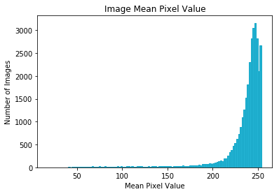
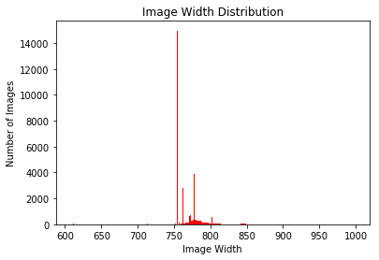
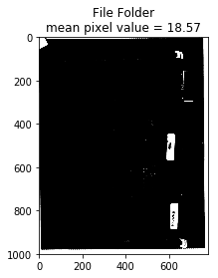
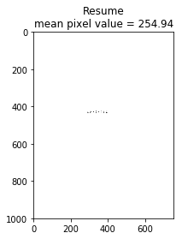
All images are 1000 pixels tall
Most are 1000x752
The majority of images are mostly weight space
Darkest image (18.57 mean value)
Whitest image (254.94 mean values)
0 is pure black, 255 is pure white on grayscale

Slide 5
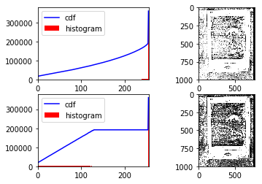
PREPROCESSING
Histogram Equalization
Attempting to make the cumulative of pixel values as linear as possible to spread the distribution of influential features

Slide 6
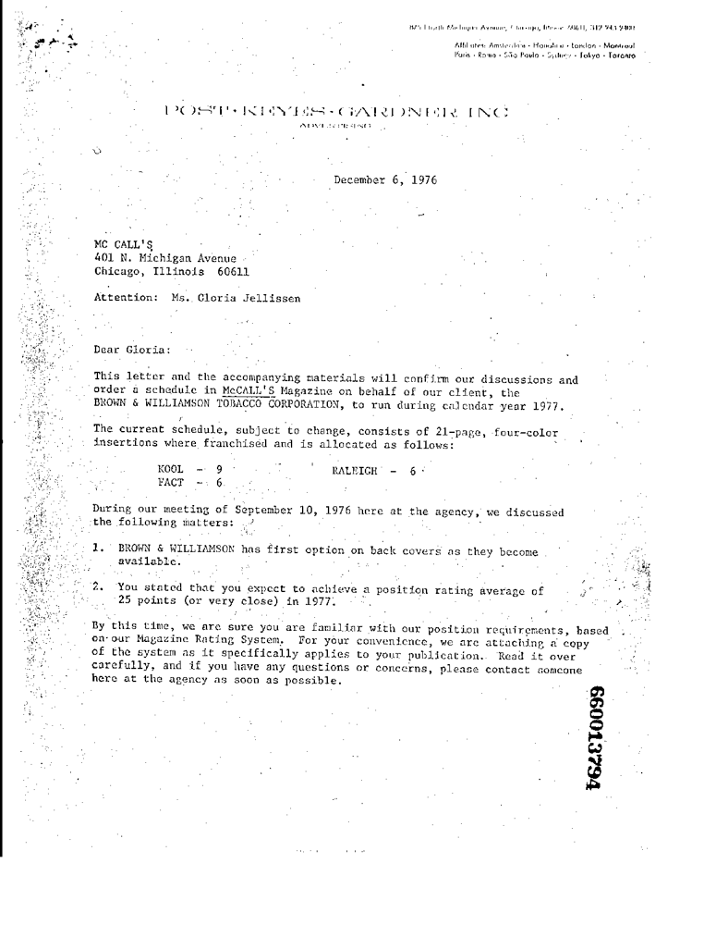

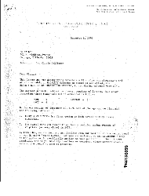


(1000, 782)
(500, 381)
(250, 190)
(125, 95)
(62, 47)

Slide 7
FINAL DATASET
32,000 training images (2000 per class)
12,000 testing images (750 per class)
12,000 validation (750 per class)
All images resized to 224 x 224 for initial analysis

Slide 8
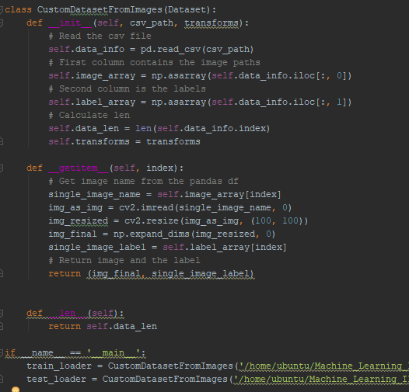
PyTorch
Loading custom dataset requires a custom data loader wrapped around PyTorch’s Dataset class.
Create .csv for each dataset with two columns:
Full image path
Class label
Read and process with OpenCV
OpenCV: (height, width, # channels)
PyTorch: (# channels, height, width)
Need to reshape

Slide 9
Tuning Training Features
Preprocessing
Histogram Equalization
Image Size
50, 100, 224
Batch Size
10, 50, 100
Learning Rate
1e-2, 1e-3, 1e-4, 1e-5
Kernel Size
11-9-7-3
7-7-5-5-3
3-3-3-3-3

Slide 10
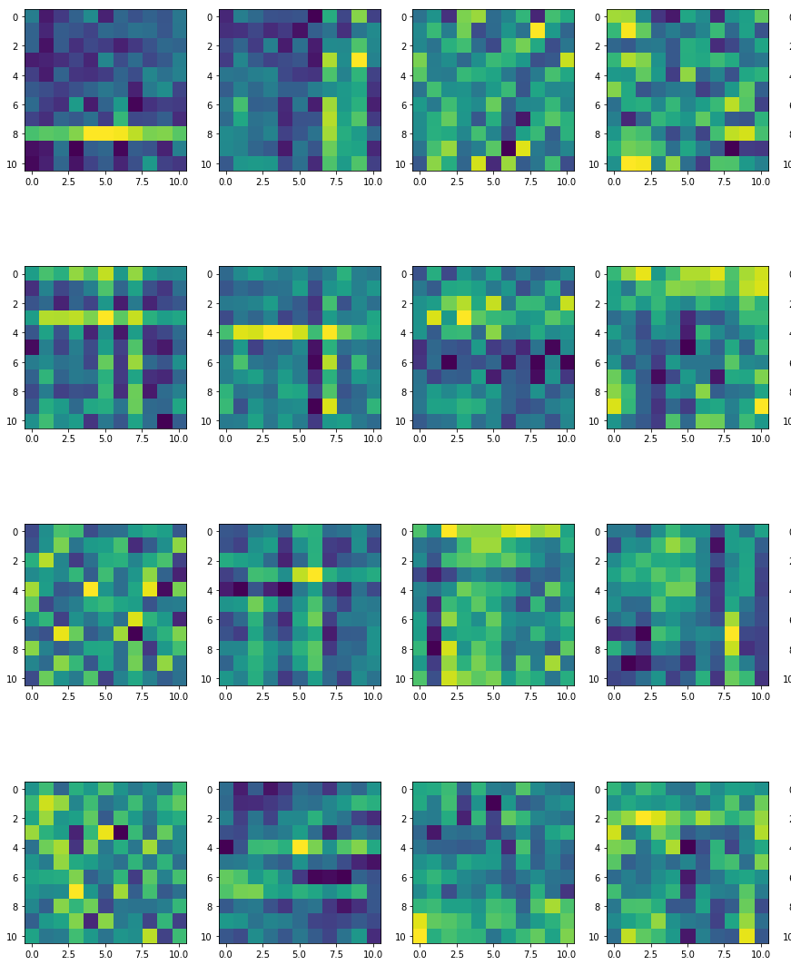
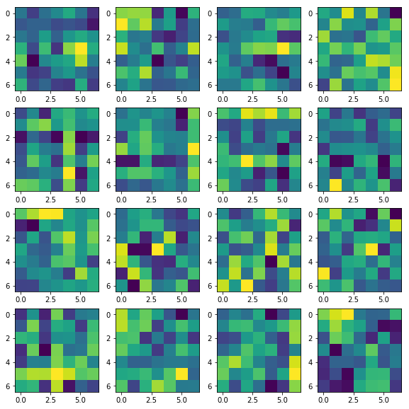
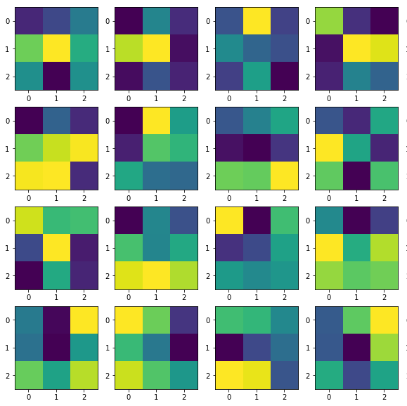
11 x 11 Kernel
7 x 7 Kernel
3 x 3 Kernel

Slide 11
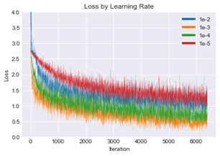
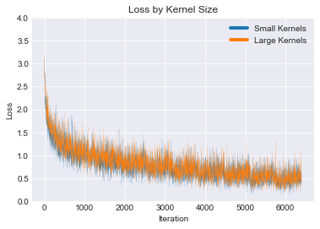
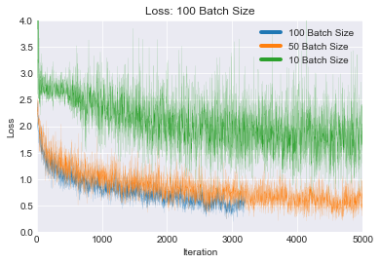
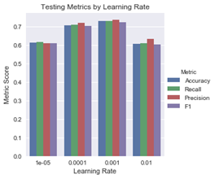
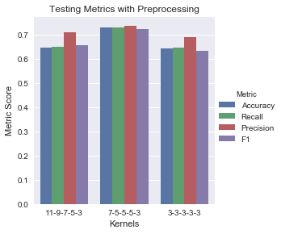
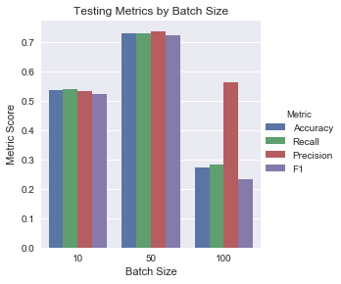
Learning Rate Kernel Size Batch Size

Slide 12
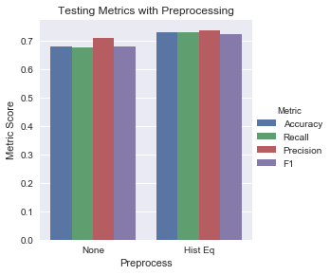
POOLING TYPE ACCURACY RECALL PRECISION F1 AVERAGE0.304 0.308 0.469 0.279 MAX 0.728 0.729 0.736 0.7234

Slide 13


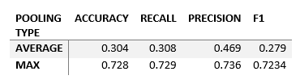
Other Experimentation
Both Emails

Slide 14
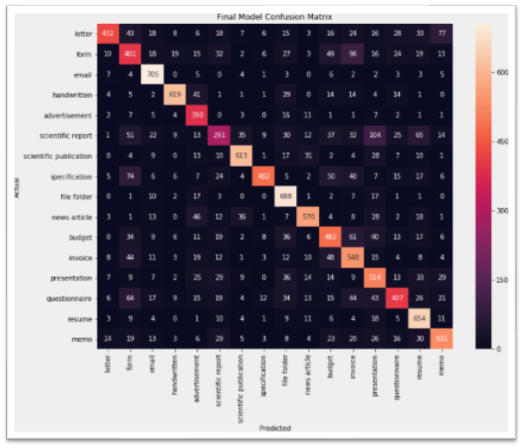
Accuracy | 0.728
Recall | 0.729
Precision | 0.736
F1 | 0.7234
Architecture:
Hist Equalization
224x224 Images
5 Conv Blocks
Two FC w/ Dropout
7-5-5-3-3 Kernels
50 Batch Size
0.001 Learning Rate
Full Image

Slide 15
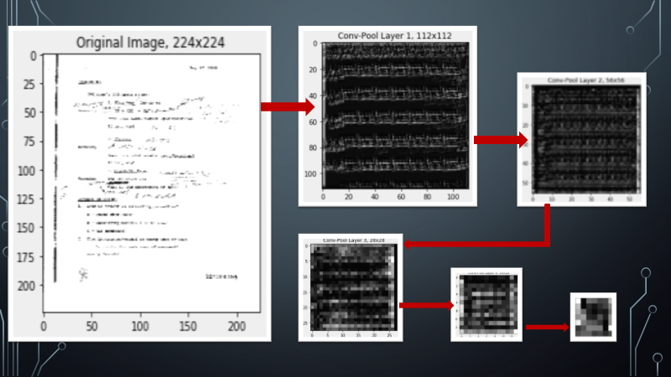

Slide 16
Keras
Preprocessing
Convolution Neural Network
VGG16

Slide 17
Preprocessing
convert_4darray: Function which takes image as input, rescales the image as 224*224 pixels and then converts it into a 4D array .
convert_4darrays: Function which takes image paths as input and returns a 4D array of images using convert_4d array function.
The images are rescaled by dividing every pixel in every image by 255.

Slide 18
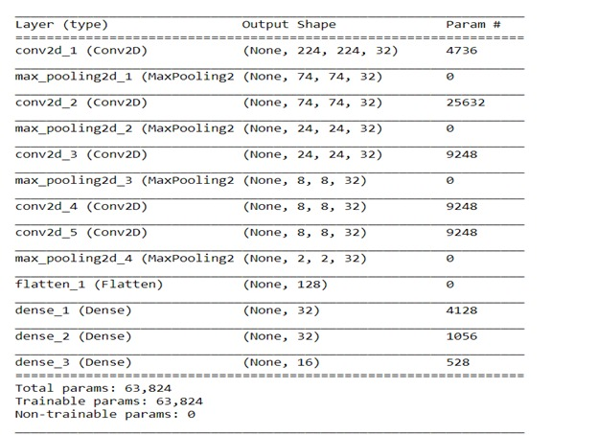
Convolution Neural Network
Header: Train images: 144 per class, Test and validation images: 120 per class
Whole: Train images: 137 per class, Test and validation images: 60 per class
epochs: 10
optimizer: adam
batch_size: 32, 64
Result: Very low accuracy

Slide 19
Transfer Learning
Process of taking a pre-trained model and “fine-tuning” the model with new dataset.
VGG16 is used in this dataset.

Slide 20
VGG16
Also called Oxfordnet
Named after Visual Geometry Group of Oxford
16 layer deep network
Can classify upto 1000 images
imported from keras.applications
contains models with weights trained on Imagenet

Slide 21
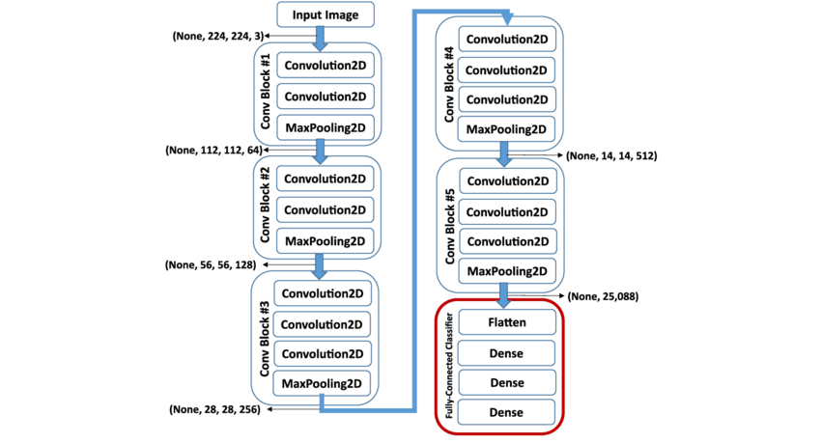
VGG16 Architecture

Slide 22
VGG16(include_top = False, weights = ‘imagenet’, input_tensor = None, input_shape = None, pooling = None, classes= 1000)
Arguments:
1. include_top: decides whether to include 3-fully connected layers at the top of the network
2. weights:
a. None: the weights are randomly initialized.
b. imagenet: uses weights form pre-trained Imagenet.
3. input _tensor: optional. This is output of layers.Input()
4. input_shape: optional.
Only specified if include_top is specified as False. Else the input_shape has to be 224*224 which channels 3.
5. pooling: optional. Used for feature extraction when include_top is specified as False.
a. None:
b. avg
c. max:
6. classes: optional. Only to be specified if include_top is False, and weights is specified as ‘None’.
Specifies number of classes to classify images into.

Slide 23
VGG16
Header: Train images: 144 per class, Test and validation images: 120 per class
Whole: Train images: 137 per class, Test and validation images: 60 per class
optimizers used: SGD, RMSprop, Adam
Adam has good accuracy compared to other two optimizers
batch_size: 32, 64
Accuracy: 66.67
Improved accuracy compared to previous CNN model.

Slide 24
Future Directions
Train the model in such a way that when given an input image the model should classify the image automatically.
Read data from the document images
Reduce class separation and combine into more homogeneous classes
Create top-5 classification for less certain predictions

Slide 25
Conclusions
Document images more difficult to identify than natural images
High intraclass variance makes identification even more difficult
PyTorch produced the best results
Transfer learning such a VGG may not be as good as custom network for non-natural imagery. Needs more research.

